Slide 1
TA 111: Technical Arts
2023-24 II
Lecture 23
Development of Surfaces- I
Dr. Syam Nair
Department of Civil Engineering
IIT Kanpur
Office: FB 307
Phone: 6424
Email: syamnair@iitk.ac.in

Slide 2



Intersection of Cone and Prism

Slide 3
Cone and Prism: Selected Line Method
2
1
12
3
n
i
11
k
i
g
k
4
e
e
l
c
a
a
c
10
b
O
b
l
j
d
d
5
h
f
h
j
9
6
m
7
8
O
O
a
b, c
a
d, e
b
c
f, g
d
e
f
g
m, n
m
h
i
n
h, i
j, k
j
k
l
l
4
10
7
1
3, 5
2, 6
1, 7
8, 12
9, 11
6, 8
5, 9
4, 10
3, 11
2, 12

Slide 4
Mandatory Reading
Thomas E. French, “Engineering Drawing and Graphics Technology”
Chapter 11 – Developed Views

Slide 5
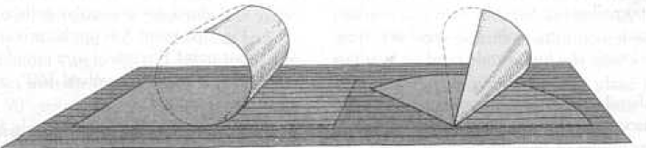
Development of Surfaces
In manufacturing industry, full-size patterns of surfaces of an object are required
Ex.: Sheet-metal work, sheet need to be cut or rolled, folded, or formed to make the complete object
  Sheet needs to be laid out in a plane, true edges and surfaces should be marked on it

Slide 6
Objects

Slide 7
Objects

Slide 8
Prism
Complete surface laid out in a ‘plane’ is called the ‘development’ of the surface
Developable: Objects made of planes and single-curved surfaces
Non-developable: Warped and double-curved surfaces – Ex. Ball

Slide 9
Prism
If true sizes of all plane faces are found and the faces joined in order at their common edges: all phases lie on a common plane and the result will be the developed surface
True length of edges

Slide 10
Prism

Slide 11
Prism

Slide 12
Prism

Slide 13
Prism

Slide 14
Pyramid

Slide 15
Pyramid

Slide 16
Pyramid

Slide 17
Pyramid

Slide 18
Pyramid

Slide 19
Cylinder

Slide 20
Cone

Slide 21
Truncated Pyramid

Slide 22
Getting True Length
True Length of a Line can be found by
Auxiliary View Method
Method of Rotation
True Length Diagram
B_{A}
TL
C_{A}
A
H
B_{H}
Methods 2 and 3 are used extensively for development of surfaces
C_{H}
A_{A}
C_{F}
A_{H}
H
TL of AB
F
A_{F}
C_{F}
B_{F}
A_{H}
B_{H}
True Length Diagram
B_{F}
Can we use line A_{F}B_{F} to find TL of AB?

Slide 23
Getting True Length
Y_{H}
X
AXIS
X_{H}
Y_{HR}
H
F
X_{F}
F
Ø
Y
O
TL
H
Y_{R}
TL
Ø
O_{F}
Y_{F}
Y_{FR}
Note that if true altitude and base of a line are known,
the hypotenuse is the TL of the edge.

Slide 24
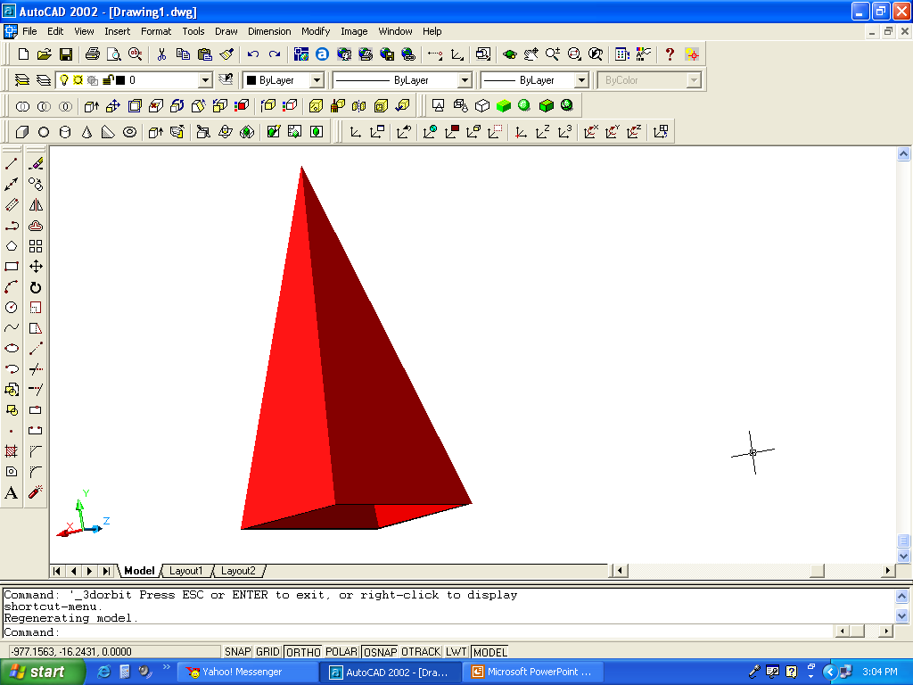
Rectangular Pyramid
The key is to find TL of all the edges and lay them out
Which sides are in TL?
TL of other sides of the pyramid (e.g. OA) has to be found
Once found, mark-off TLs to the develop surface
C_{H}
D_{H}
A_{I}
O
O_{H}
D_{I}
H
B_{H}
A_{H}
F
O_{F}
O_{I}
TL
C_{I}
B
A
A_{R}
B_{I}
B_{F,}C_{F}
A_{F,}D_{F}
C
D
A_{I}

Slide 25
Oblique Rectangular Pyramid
O
3
4
O
1
3
2
2
1
H
O
F
O
O’
O’’
1
1
TL _{O3}
TL _{O1}
2
4
2,3
1,4
3

Slide 26
Thank You !!!

